Slide 1
Introduction
EA teams across many industries are often frustrated by in their attempts to deliver value. Key stakeholders at various levels do not act in line with EA guidance.
To be effective, EA teams need to have the support of those who provide resources, those who deliver change and those who are subject to change.
But, before seeking to change how stakeholders act, the EA team and its leadership must be acting in a way that supports EA goals and effective stakeholder engagement.
This deck, based on practical behavioural science techniques, aims to help create a plan for developing EA team, EA leadership and stakeholder behaviours that support the delivery of EA team goals.

Slide 2
Agenda
The method
Understanding the audience
Designing interventions
Modelling behaviours

Slide 3
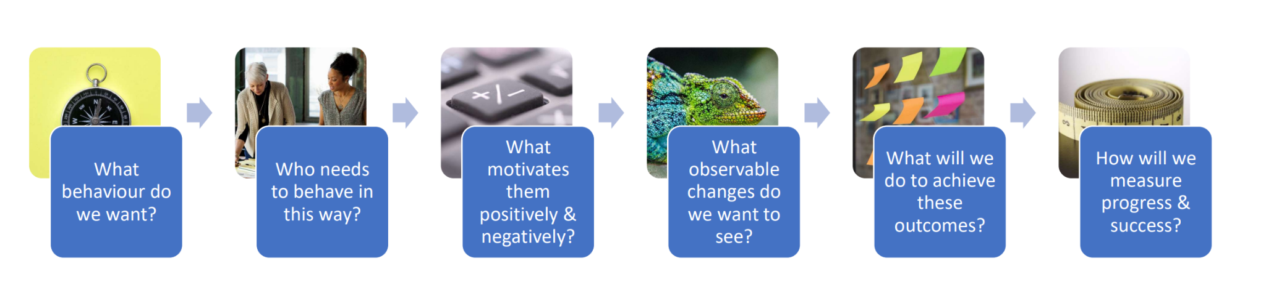
The method
We use the 6 steps from the behaviour science toolkit

Slide 4
Problem statement
Who’s impacted
Why is it important now?
Target behaviour:
1) Who needs to perform the behaviour?
2) What does the person need to do differently to achieve the desired change?
3) When will they do it?
4) Where will they do it?
5) How often will they do it?
6) With whom will they do it?
Group of people + action verb in the present tense + details (frequency, time, quantity, duration, place)
Current behaviour:
1) identify as specifically as possible the behaviour or behaviours that need to be changed to solve the problem;
2) specify the location(s) in which the behaviour occurs
3) specify the audience - individual, group or population involved

Slide 5
The Audience
EA Team
EA Leadership
Priority Stakeholders
Key Influencers
Prefer
Evidence
Goals - what do they have to achieve?
Jobs - what activities do they carry out?
Pain points - what makes their job difficult?
Gain points - what gives them pleasure in their job?
Rewards - what are they rewarded for?
Desires - what else do they want to achieve through their job?
Distance from desired behaviour
Attitude towards desired behaviour
Over
Assumption
Use existing records, observation, surveys and interviews to gather evidence

Slide 6
Influences on behaviour
Question audience members on what influences their behaviour to build a picture of motivations
Influences | Description
Perceived ability | A person’s belief that they have the required confidence, knowledge, and ability
Perceived rewards | What positive things does a person think will happen if they practices the behaviour? What will be the benefits & advantages?
Perceived negative consequences | What negative things does a person think will happen if they practices the behaviour? What will be the costs & disadvantages?
Perceived Social Norms | A person’s perception of whether others will approve or disapprove of them practicing the behaviour
Access | The extent to which a person can access the required resources to practice the behaviour
Cues for Action | The presence of reminders that help a person to remember to practice the behaviour or the steps involved in the behaviour
Perceived Susceptibility | A person’s perception of how likely it is that they will be affected by the problem the behaviour is addressing
Perceived Severity | A person’s perception of how seriously affected they can be by the problem the behaviour is addressing
Perceived Effectiveness | A person’s belief that doing the behaviour will address the problem
Perceived Control | A person’s belief that that they have limited control over the problem
Policy | Laws and regulations that affect behaviours and access to resources
Culture | The extent to which values or lifestyles influence (not) doing the behaviour

Slide 7
Modelling behaviours
The modelling approach is to use a simple cause and effect structure annotated with the evidence and assumptions.
Assumption
Motivation
Behaviour
Outcome
Motivation
Conflict
Behaviour
Outcome
Motivation
Motivation
Behaviour
Outcome
Evidence
Motivation
Behaviour
Outcome
Obstacle

Slide 8
Describe the required change
Increase / decrease / improve / reduce …
the perception that …
(or) the availability of/ access to… (resource)
(or) the ability to… (do something)
How will these be measured (baseline and changes)?

Slide 9
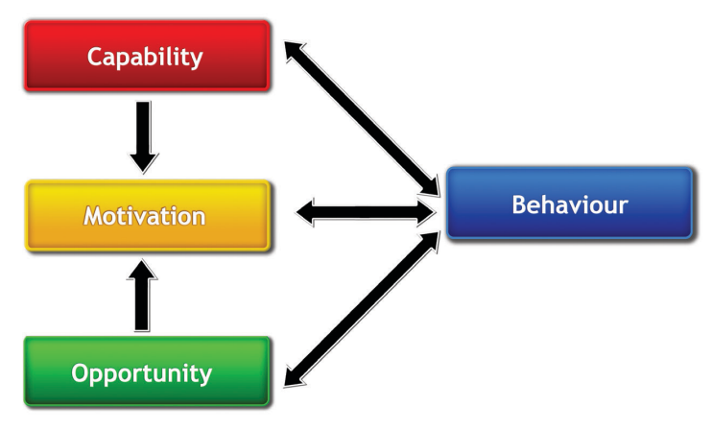
COM-B Model
For any behaviour to occur:
1. there must be the ‘capability’ to do it: the person or people concerned must have the physical strength, knowledge, skills, stamina etc. to perform the behaviour;
2. there must be the ‘opportunity’ for the behaviour to occur in terms of a conducive physical and social environment: e.g. it must be physically accessible, affordable, socially acceptable and there must be sufficient time;
3. there must be sufficient strong ‘motivation’: i.e. they must be more highly motivated to do the behaviour at the relevant time than not to do the behaviour, or to engage in a competing behaviour
Interventions should aim to improve capability, opportunity and motivation.

Slide 10
Characteristics of good interventions
Easy: Learn what makes practicing the behaviour difficult and help your priority groups to make it easier – involving less hassle, time or money. If you promote a complex goal, break it down into smaller actions.
Attractive: People are motivated to do something when it brings them what they want most, such as income, peace of mind, happiness, or good health. Ensure that your activities help people experience the benefits of practicing the behaviour by, for example, letting them test it; sharing successful examples; and using appealing messages that engage people’s emotions.
Social: People are heavily influenced by what people around them do. So let’s take advantage of it! Showing that some people already practice the promoted behaviour, using the power of social networks (e.g. peer-to-peer), or encouraging people to commit to someone to practice a behaviour often works well!
Timely: The same campaign conducted at different times can have drastically different levels of success. Schedule your campaign for when people are most receptive.

Slide 11
Types of Intervention
Intervention | Description
Educate | Increasing knowledge and understanding
Train | Passing on specific skills - off the shelf training, tailored training, on-the-job training
Persuade | Using communication to induce positive or negative feelings or stimulate action
Reward | Create an expectation of benefit or advantage
Punish | Create an expectation of loss or disadvantage
Restrict | Make it more difficult to engage in negative behaviours
Restructure | Change the organisation, processes, tools to encourage positive behaviours
Model | Provide examples of good for others to follow or replicate
Empower | Provide resources and authority
Enable | Other methods of helping people to adopt positive behaviours
Counsel | Provide tailored advice to address specific needs
Collaborate | Collaborate with the audience to solve problems
Support | Embed as peers to solve problems
Extend | Create new services to address problems
Advocate | Find respected advocates to promote positive behaviours

Slide 12
Designing interventions
Interventions should be:
Sustainable
Scaleable
Measureable

Slide 13
Modelling Interventions
Motivation
Conflict
Resolution
Behaviour
Outcome
Motivation
Intervention
Motivation
Behaviour
Outcome
Obstacle
Intervention
Intervention
Assumption
Motivation
Motivation
Behaviour
Outcome
Evidence
Measure

Slide 14
Sources
The workshop draws on the following sources:
Behaviour Change Toolkit
Published by: People in Need (PIN) in 2017
Author: Petr Schmied
ISBN: 978-80-87456-83-5
The Behaviour Change Wheel
Published by: Silverback Publishing in 2014
Author: Susan Michie, Lou Atkins, Robert West
ISBN: 978-1-912141-08-1

